Slide 1
Contest take up
[5/14/2021]

Slide 2
Table of Contents
Problem A-F
End of year wrap up

Slide 3
Problem A

Slide 4
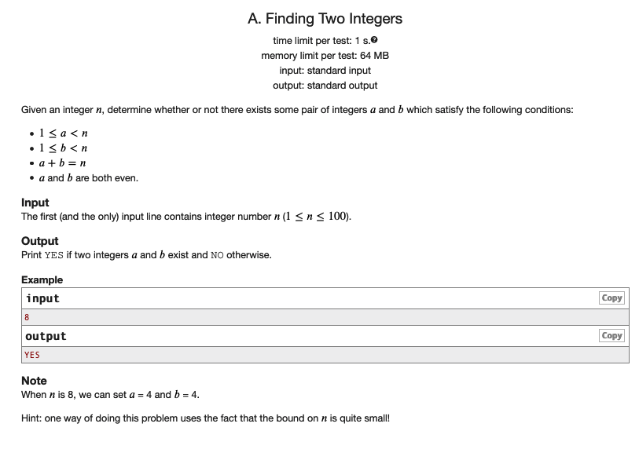
Statement

Slide 5
Examples
n = 5
No solution
n = 8
a = 2, b = 6
n = 12
a = 2, b = 10
n = 2
No solution

Slide 6
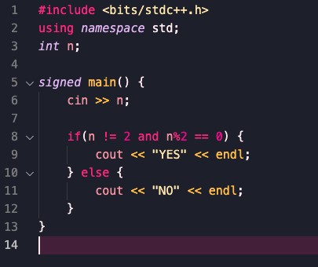
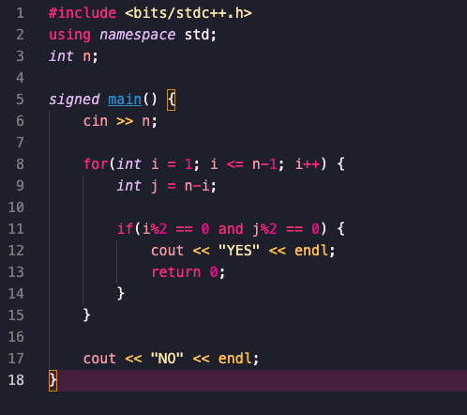
Problem A Solution
Casework - If the number is even you can always use 2 and n-2
The only edge case is when n=2, where you should print “NO”
O(1) time complexity
You could also use one or two loops to brute force on a and b
O(N) or O(N^2)

Slide 7
Problem B

Slide 8
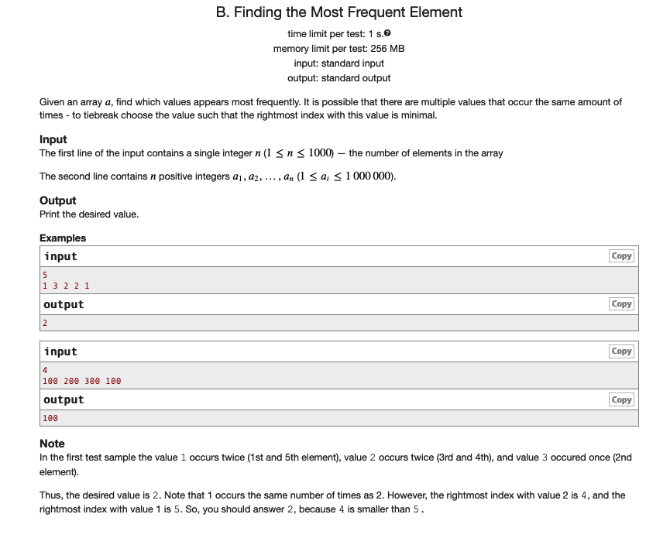
Statement
Important: “to tiebreak choose the value such that the rightmost index with this value is minimal”

Slide 9
Sample
Index | 1 | 2 | 3 | 4 | 5
Value | 1 | 3 | 2 | 2 | 1
1 occurs 2 times
2 occurs 2 times
3 occurs 1 time
Pick 2 because 4<5

Slide 10
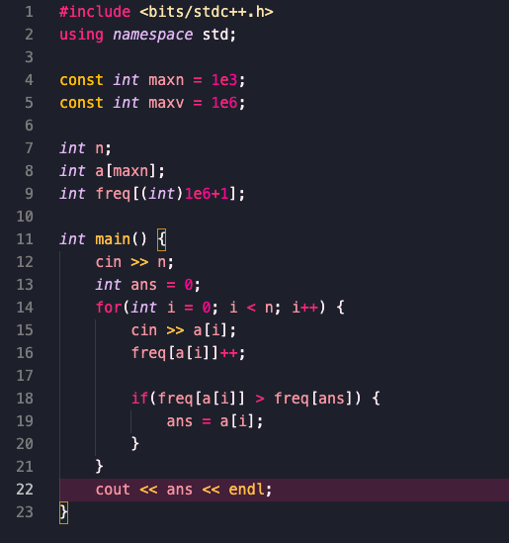
Problem B solution
This problem mostly tested knowledge of frequency arrays and for loops. Iterate over the array, keeping track of how often each element appears, and update the total maximum if we have a strictly better number.

Slide 11
Problem C

Slide 12
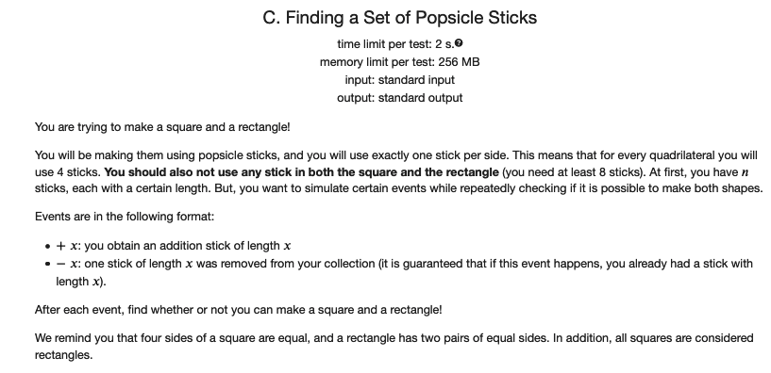
Problem C

Slide 13
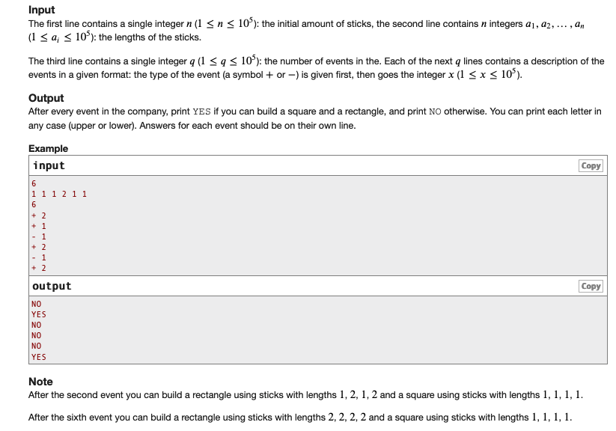
Problem C(cont’d)

Slide 14
Problem C Solution
This problem tested for implementation skill. We should maintain a frequency array of each element (like in B). There are many ways to implement this.
In addition, we maintain two variables sq and pairs. pairs represents the number of pairs of equal elements, and sq represents the number of possible squares we can make. Note that if an edge is used in sq, it should be removed from pairs. In general, we try to maximize sq and use leftovers to contribute to pairs.
When outputting, we can notice that all squares are rectangles but not all rectangles are squares. So, check if either:
sq >= 2
sq >= 1 and pairs >= 2

Slide 15
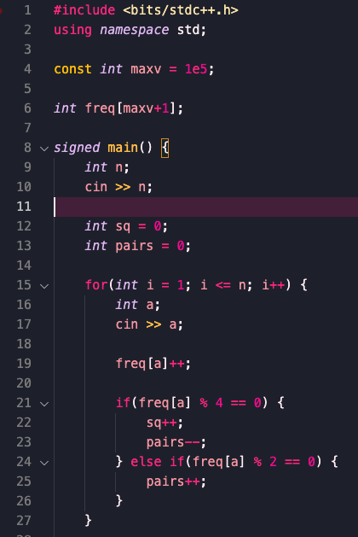
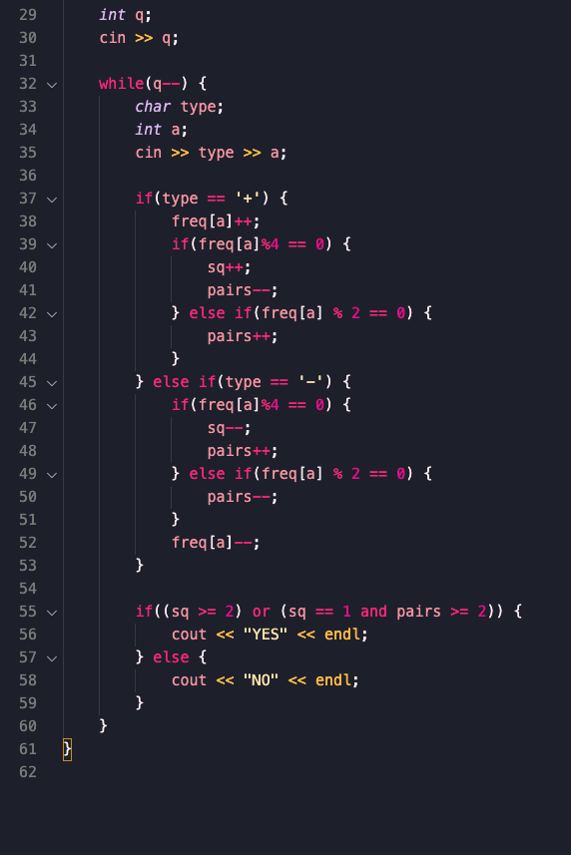
Problem C Solution (cont’d)

Slide 16
Problem D

Slide 17
Problem D solution
This problem tested for knowledge of prefix sum arrays and difference arrays (extension of prefix sums). Prefix sum arrays allow you to query the value of a prefix after O(N) processing.
Use a difference array to update your array, and use a prefix sum array to keep track of # of indexes in a range such that a[i] >= k.
Possibly easier than C?

Slide 18
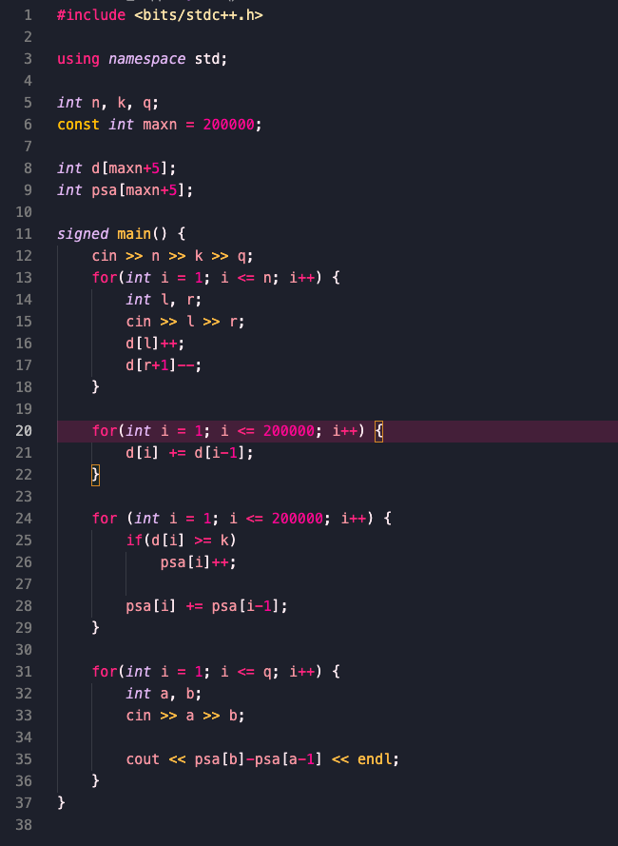
Problem D Solution (cont’d)

Slide 19
Problem E

Slide 20
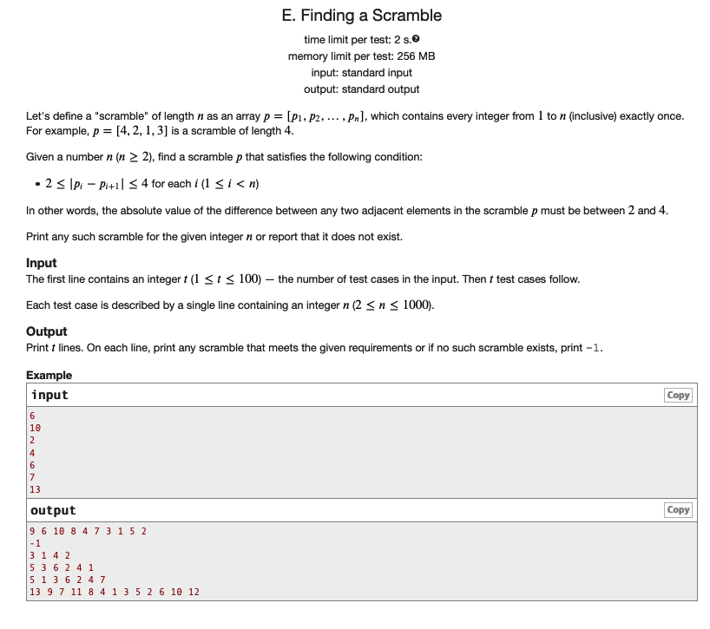
Statement

Slide 21
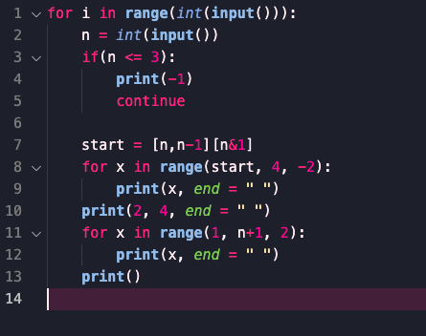
Solution
Pure constructive/ad-hoc problem with minimal coding.
One simple construction is all even numbers in descending order, 2, 4, all odd numbers in ascending order, though other constructions also exist.

Slide 22
Problem F

Slide 23
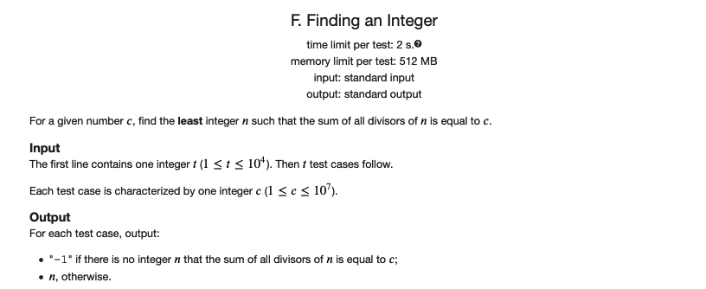
Statement

Slide 24
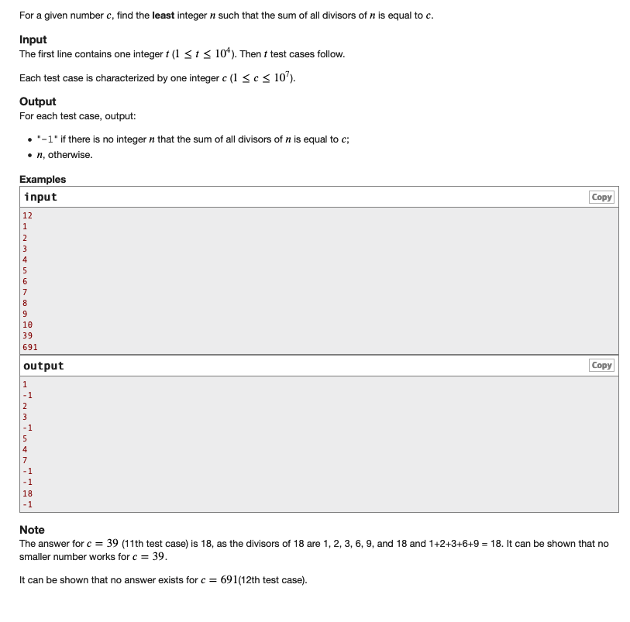
Statement (cont’d)

Slide 25
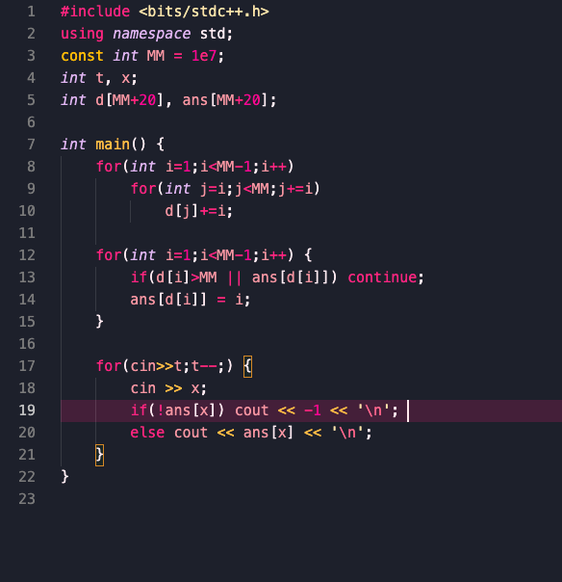
Solution - O(nlogn)
Sieve-like time complexity.
d[i] = sum of divisors of i
ans[x] = answer for x
The first for loop takes O(NlogN) time because math™

Slide 26
All code
https://gist.github.com/pidddgy/4af306f8c0b85b1b435f0e4762718ef3

Slide 27
Problem Sources
All problems were adapted from various existing problems on Codeforces.
A is https://codeforces.com/problemset/problem/4/A
B is https://codeforces.com/problemset/problem/637/A
C is https://codeforces.com/problemset/problem/1393/B
D is https://codeforces.com/problemset/problem/816/B
E is https://codeforces.com/problemset/problem/1352/G
F is https://codeforces.com/problemset/problem/1512/G
G is https://codeforces.com/problemset/problem/923/B

Slide 28
WCS Contest Prizes
Prizes:
- First place ($10 gift card)
- Participation prize (a randomly selected individual who participated in the contest, $10 gift card)
- Second place will get 3x the number of entries
- Third place will get 2x the number of entries for this prize!

Slide 29
End of Year Announcements
Let's welcome Vishnu as a new executive of the Woodlands Computer Science Club for the 2021-2022 school year!
We will also be collaborating with Hack Club next year (led by Ariel and Kaushik) for certain events/workshops.
This is still a work in progress and we are figuring things out, but we will provide updates as things get finalized.
We’re still working on how the club will operate next year, so keep your eye out for any announcements!

Slide 30
The End!
That’s all from the Woodlands Computer Science Club this year! Thank you Mr. Dutton for being an awesome teacher sponsor and thank you all for attending our meetings and creating a memorable club experience. <3

